Slide 1
South Africa vs. India Info graphics
Name
Institutional affiliation

Slide 2
Availability of resources in India vs. South Africa
India
South Africa
India's mining sector contributes 11% of the country's industrial GDP and 2.5% of total GDP.
The nation's coal reserves are the fourth largest in the world.
India's other natural resources include bauxite, chromite, diamonds, limestone, natural gas, petroleum and titanium ore.
India provides over 12% of global thorium, over 60% of global mica production and is the leading producer of manganese ore.
South Africa´s economy was originally built on natural resources: agriculture and mining.
Economical ground has been changing by years.
Today services and manufacturing have the leading role in economics.
Primary production accounts only 14% and service sectors even 53% of the GDP.
Other resources include; gold, chromium, platinum, antimony, coal, iron ore, manganese, nickel, phosphates, tin, uranium, gem, diamonds, copper, vanadium, salt, natural gas, vermiculite, limestone, asbestos, fluorspar, lead, zinc, rutile, kaolin, zirconium, silver, phosphate, gypsum, mica

Slide 3
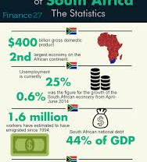
The Economy of South Africa
The 9 provinces of South Africa each contributes to the economy blossoming as shown in the next slides.

Slide 4
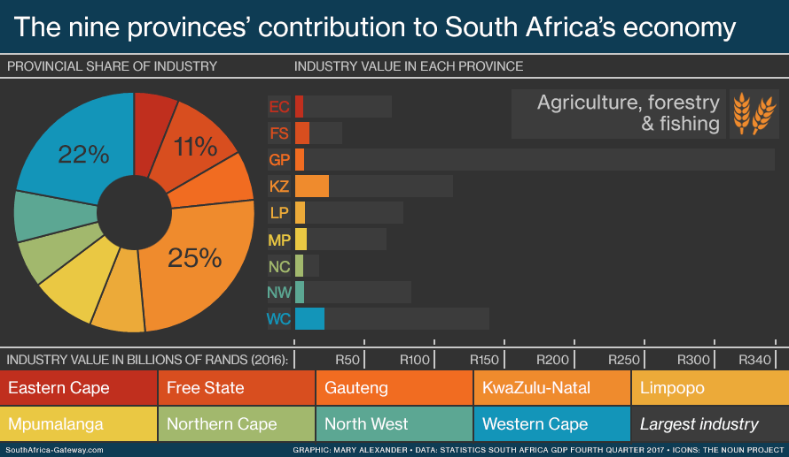

Slide 5
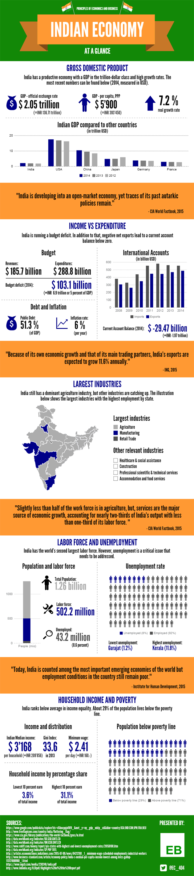
Notes:
India is the world's fourth largest economy. It has a mixed economy in agriculture and in services industry. It produced $9.4 trillion in goods and services in 2017.

Slide 6
Cultural contexts of India vs. South Africa
India
South Africa
Capital- New Delhi
Population- 1,339,180,127
Surface Area- 3,287,259 km2
Currency- Indian Rupees
Religion- Mostly Hindu
India consist of English plus 22 Indian languages: Assamese, Bengali, Bodo, Dogri,Gujarati, Hindi, Kannada, Kashmiri, Konkani, Maithili, Malayalam, Meitei, Marathi, Nepali, Oriya, Punjabi,Sanskrit, Santhali, Sindhi, Tamil, Telugu and Urdu.
Capital- Pretoria
Population- 56,522,000
Surface Area- 1,219,090 km2
Currency- South African rands
Religion- Mostly Christianity
Has eleven official languages: Afrikaans, English, Ndebele, Northern Sotho, Sotho, Swazi,Tswana, Tsonga, Venda, Xhosa, and Zulu.

Slide 7
References
Cross Cultural Report on South Africa. (2011, November 6). Retrieved from https://www.slideshare.net/abhiktushardas/cross-cultural-report-on-south-africa
Indian Economy At a Glance [Infographic] - Quickonomics. (2017, October 8). Retrieved from https://quickonomics.com/indian-economy-at-a-glance-infographic/

